Slide 1
BRAIN User manual
An Alex Sirin and Joel Braun Production

Slide 2
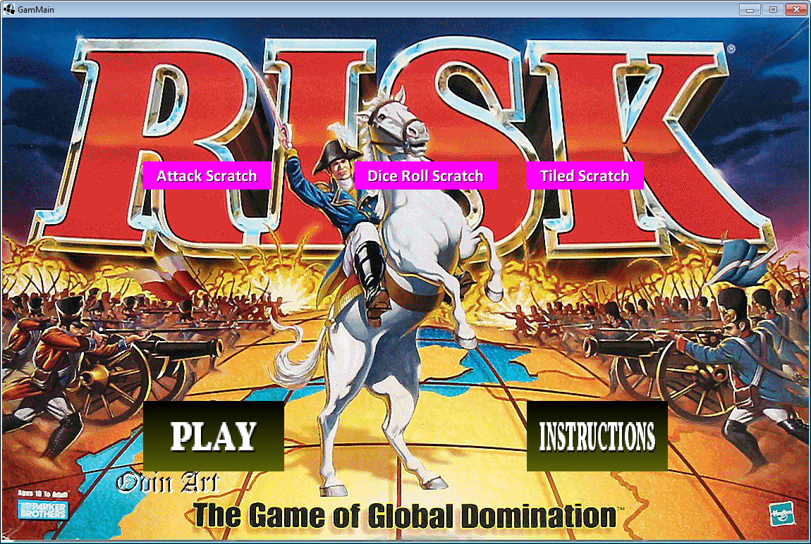
When you launch the game there are many options of what screen you would like to choose. If you would like to play the game, press the “PLAY” button. If you would like to learn how the game works, press the “INSTRUCTIONS” button. We have three scratch/ test programs which the user can see.

Slide 3
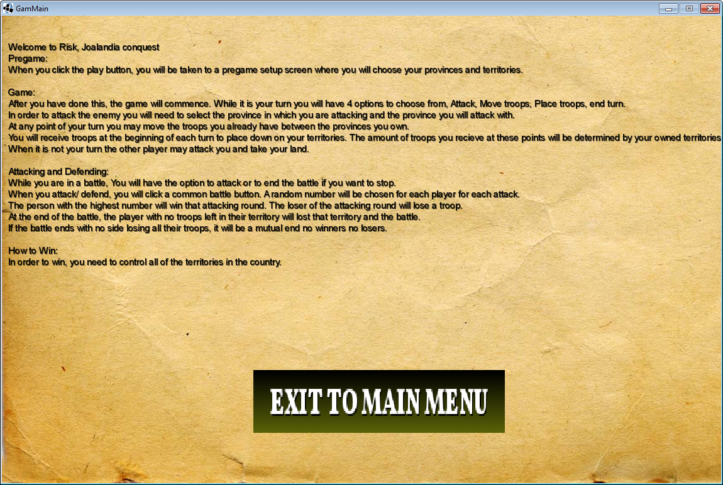
When the “INSTRUCTION” button is clicked, you are taken to the instruction screen where the user can read about how the game works. The “EXIT TO MAIN MENU” button takes the user to the main menu… (duh)

Slide 4
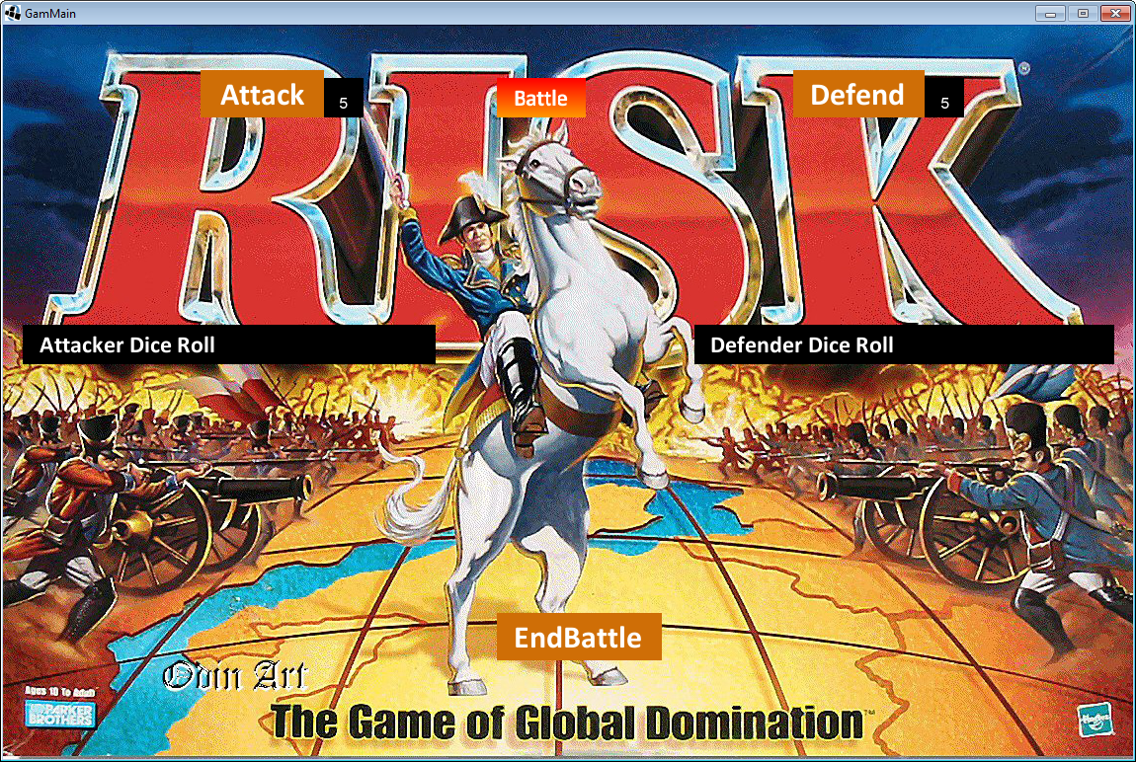
When the “attack scratch” button is pressed the user is taken to the attacking scratch, this is where the fundamental attacking mechanics were made on a basic level. Instead of dice rolls, there was only one number generated to determine the battle.

Slide 5
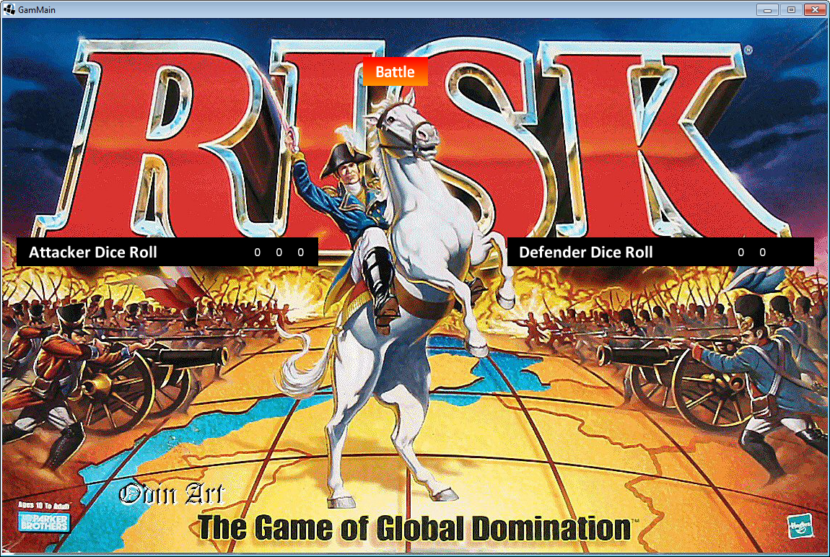
When the user clicks on the “Dice roll scratch” button they are taken to the dice rolling scratch where the concept of a more risk realistic dice rolling mechanic was tested. The battle button is hit and three dice are rolled for the attacker and two dice are rolled for the defender.

Slide 6
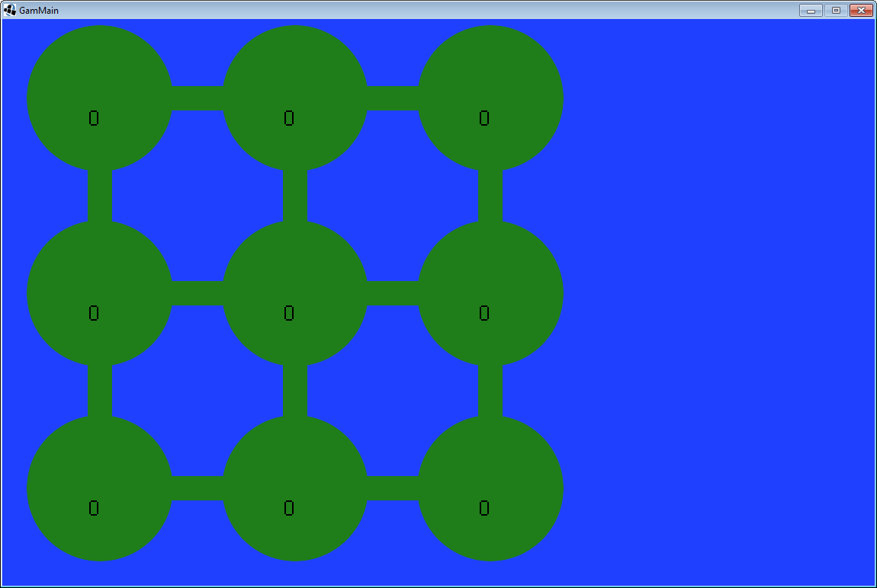
When the user clicks “tiled Scratch” they are taken to the tiled map scratch. This is where the concept of a tiled map was tested. Clicking on a tile/ territory increased the number of troops on it.

Slide 7
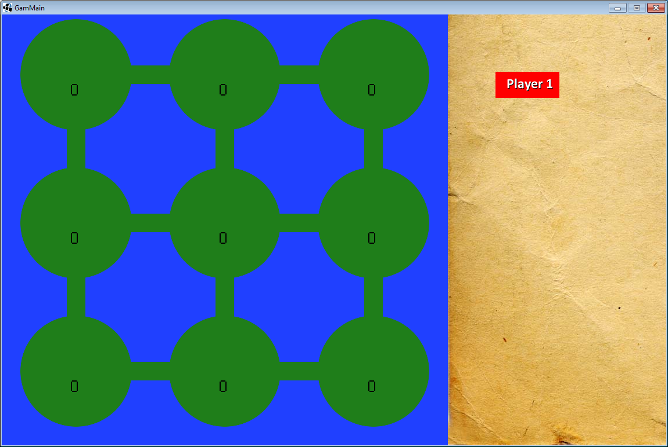
When the user clicks “Play” on the main menu, they are taken to a pregame setup screen, where they get to distribute the territories between them.

Slide 8
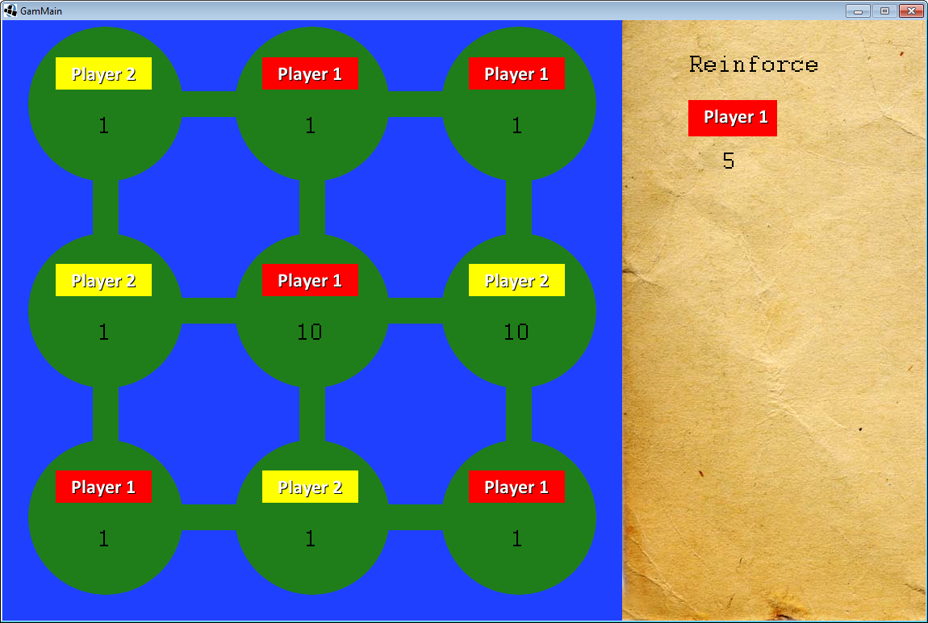
At the beginning of each turn, the user gets to place troops based on how many territories they have

Slide 9
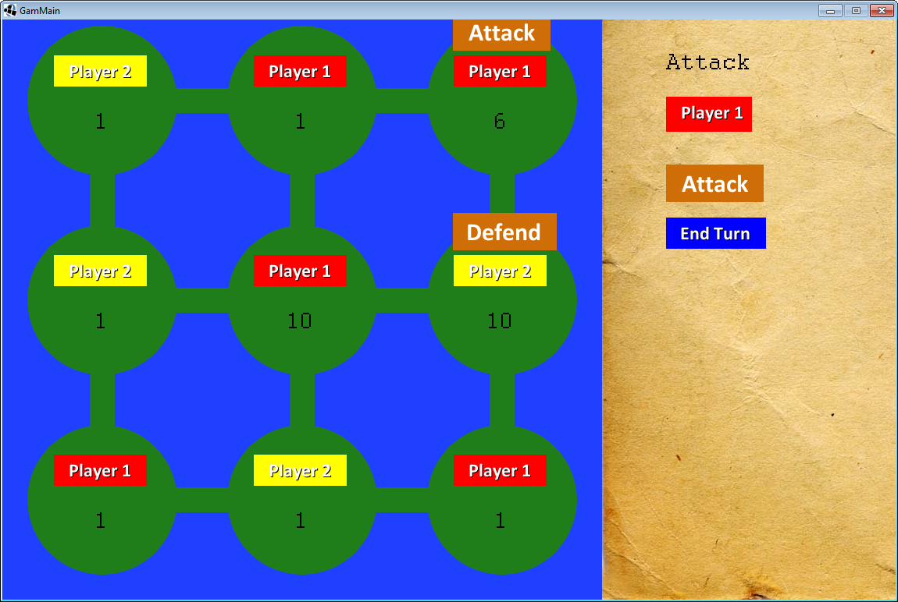
When the user is finished placing their troops they get to choose the territory they attack and attack from. Then you hit battle to initiate the battle. Press end turn to end turn.

Slide 10

When the attack button is pressed in the game screen, you have the option to initiate a battle or to end the battle.

